Slide 1
Research Report
Vo Khoi Thanh Son
28-6-2024

Slide 2
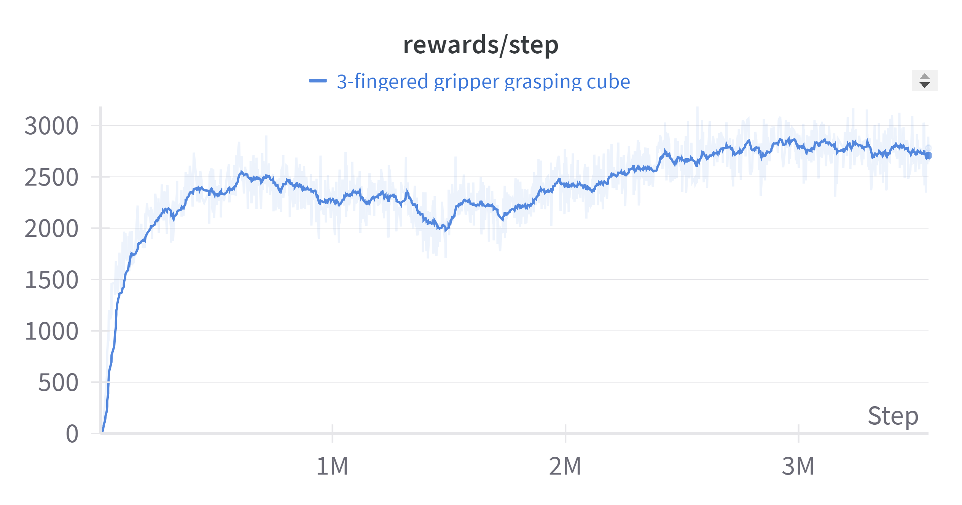
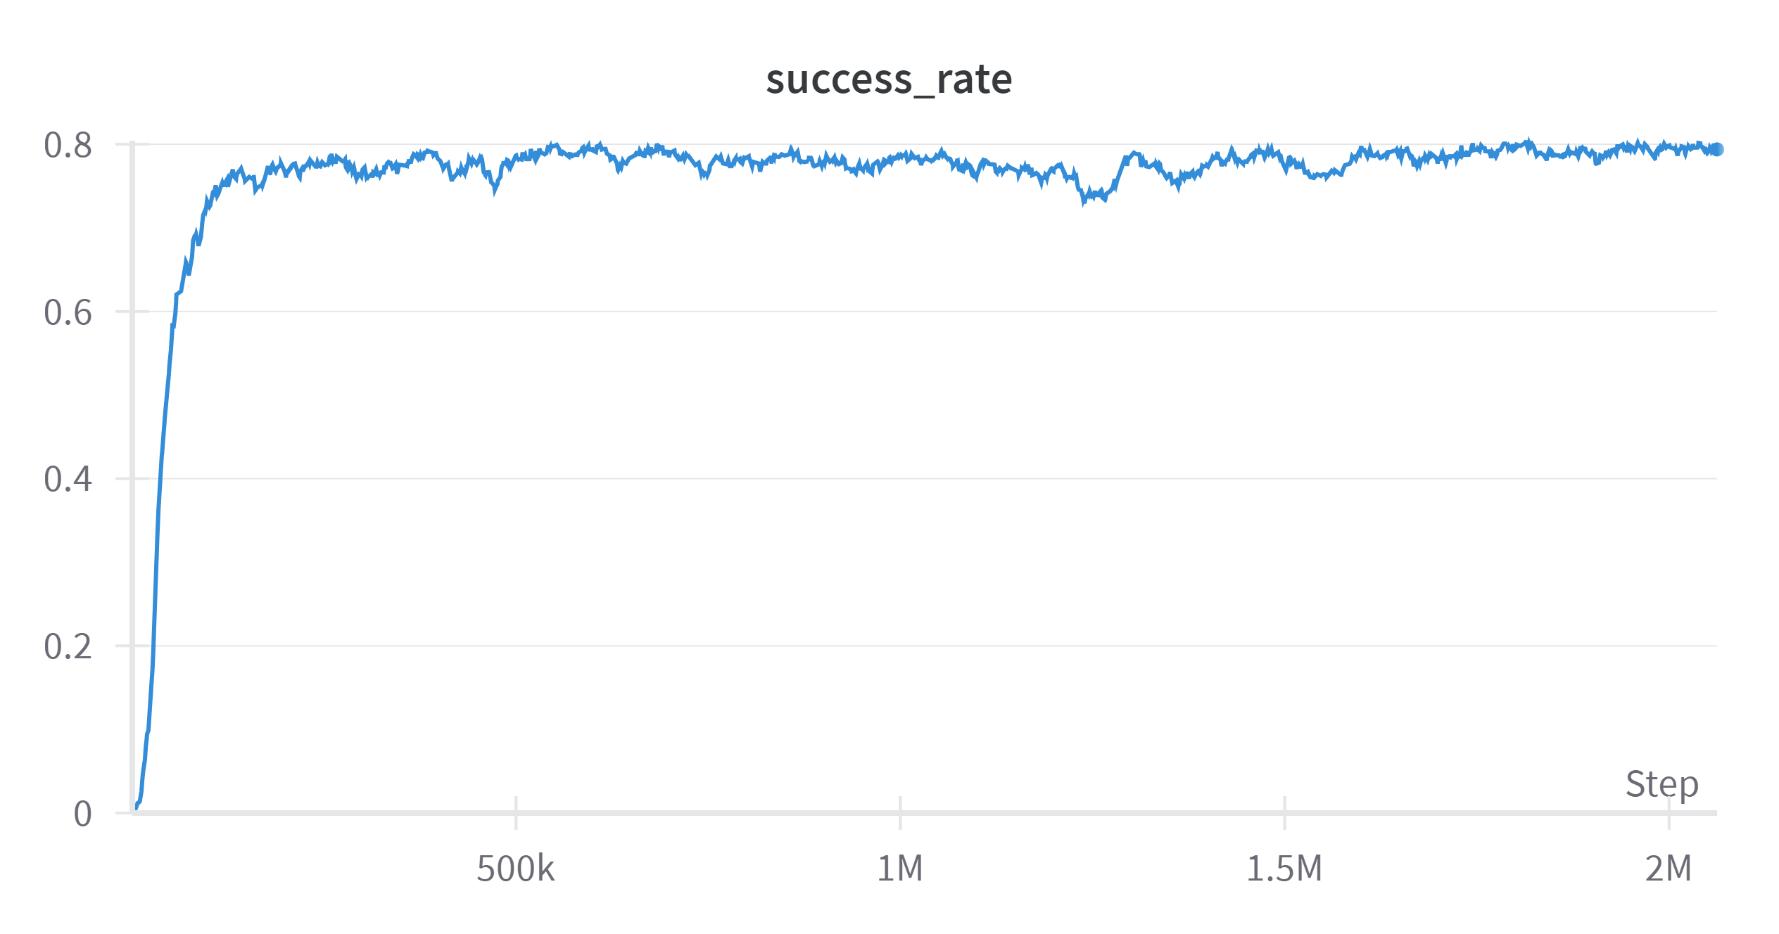
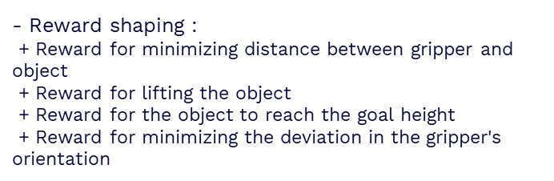
Previous work
Training the teacher policy to grasp different objects with different types of soft grippers
- Finalize the task of grasping with improved stability and success rates
→ Further reduce the rotation of gripper
→ Improvement on grasping big objects
Performance of 3–fingered gripper
- Reward shaping :
+ Reward for minimizing distance between gripper and object
+ Reward for lifting the object
+ Reward for the object to reach the goal height
+ Reward for minimizing the deviation in the gripper's orientation

Slide 3
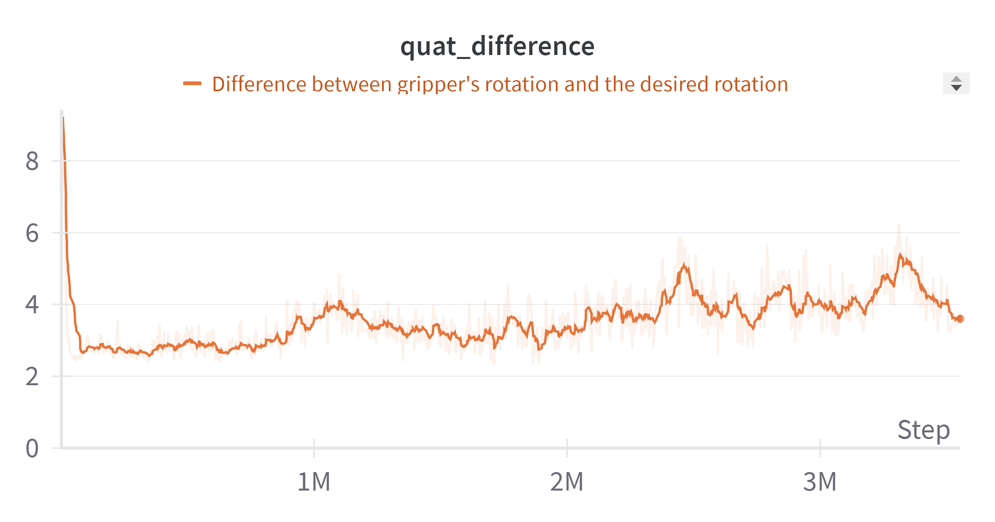
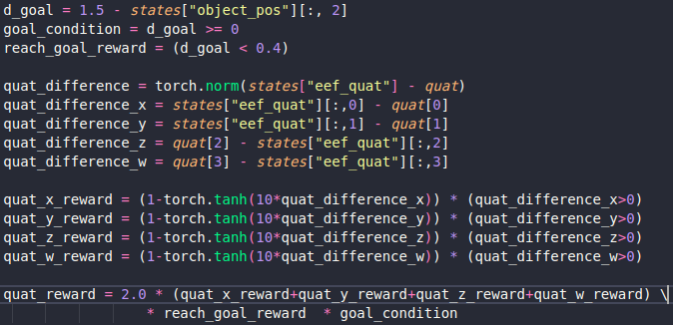
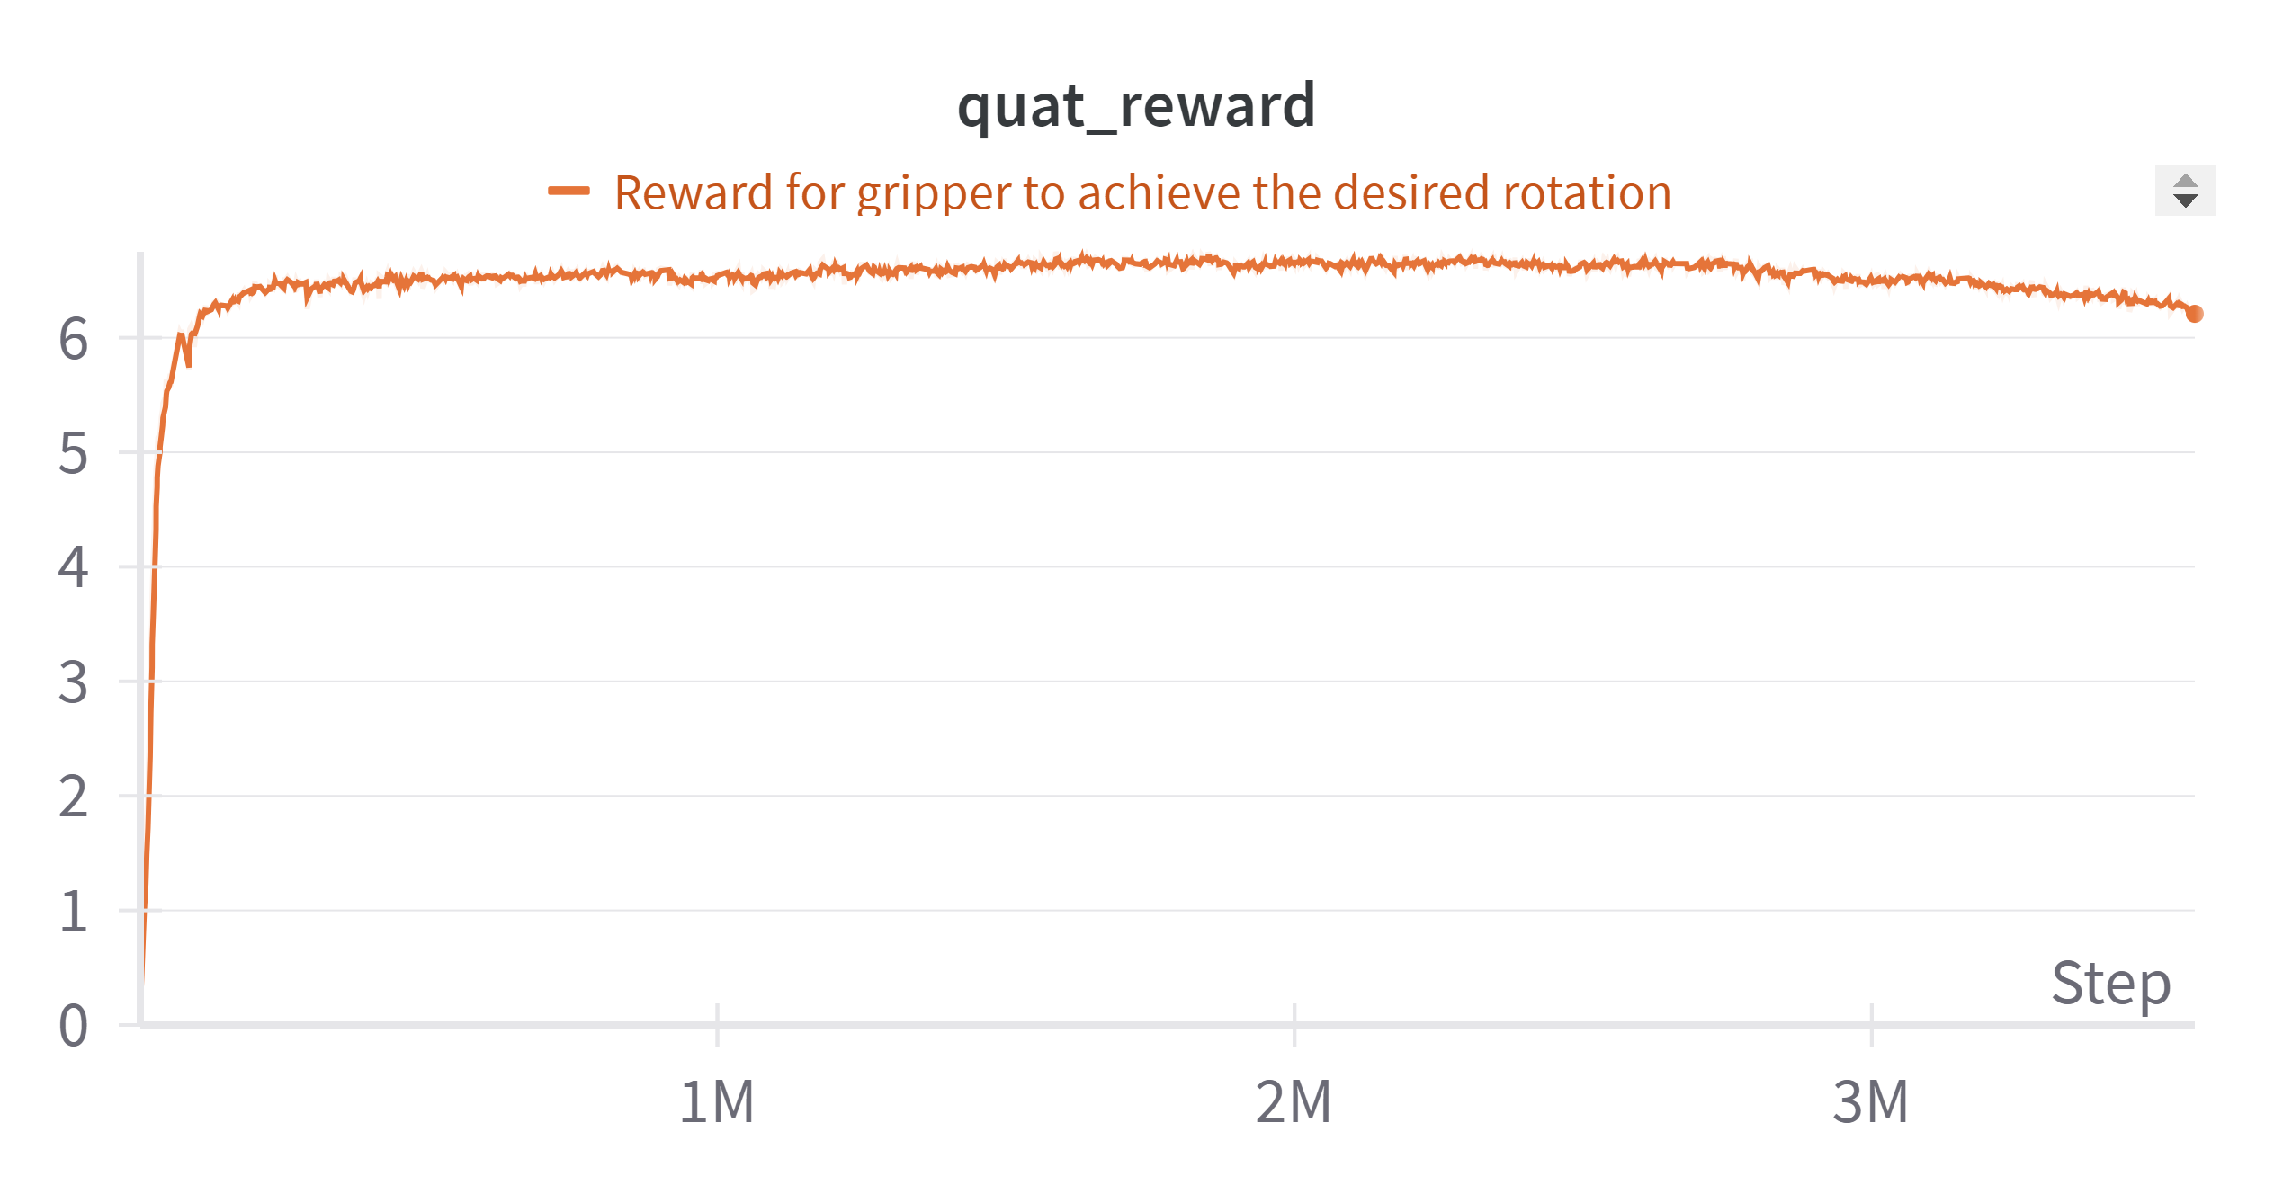
Gripper performance
desired quat (x,y,z,w) = (0,0,0,1)
- Minimize the rotation of gripper
+ Provide reward for individual component of gripper’s quaternion
Performance of 3–fingered gripper
→ Managed to obtain stable performance for gripper’s rotation

Slide 4
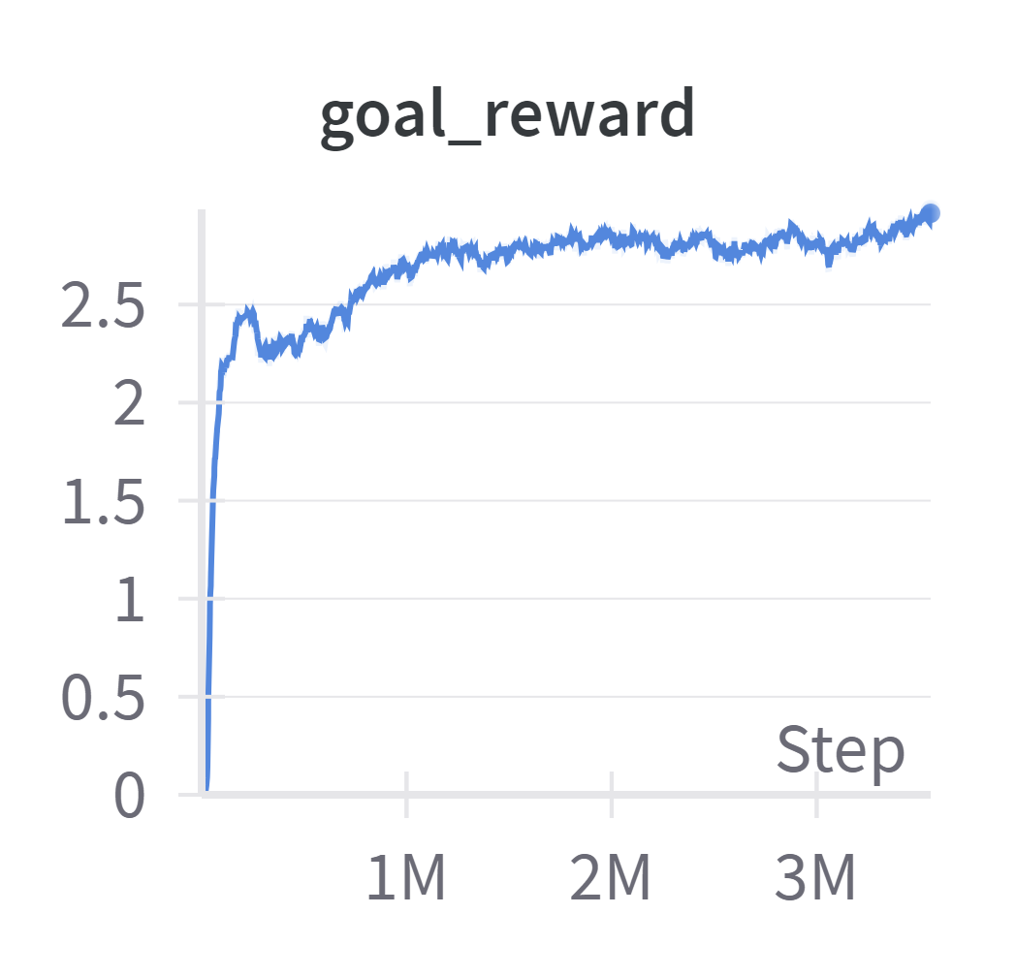
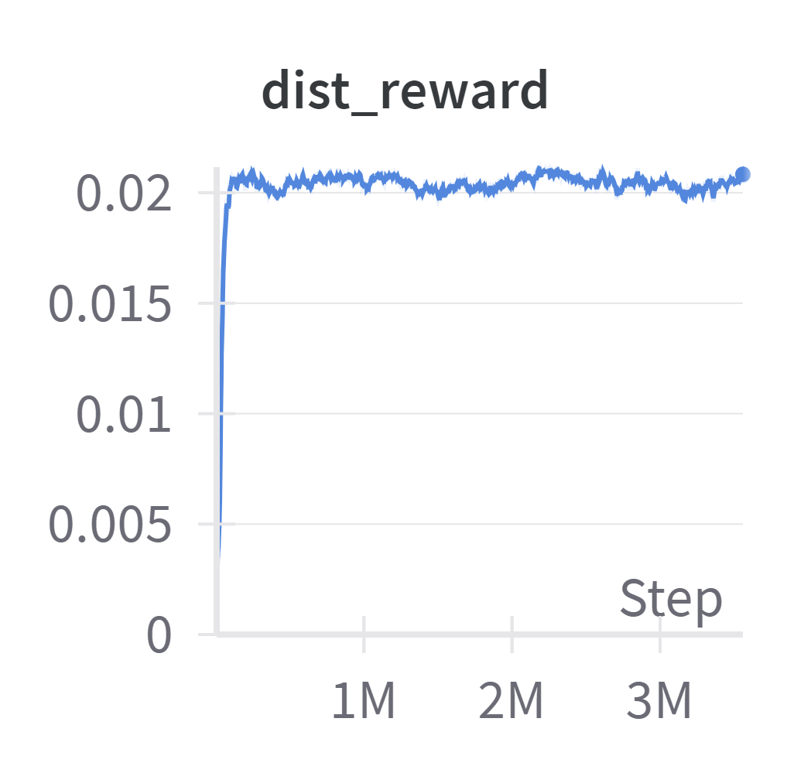
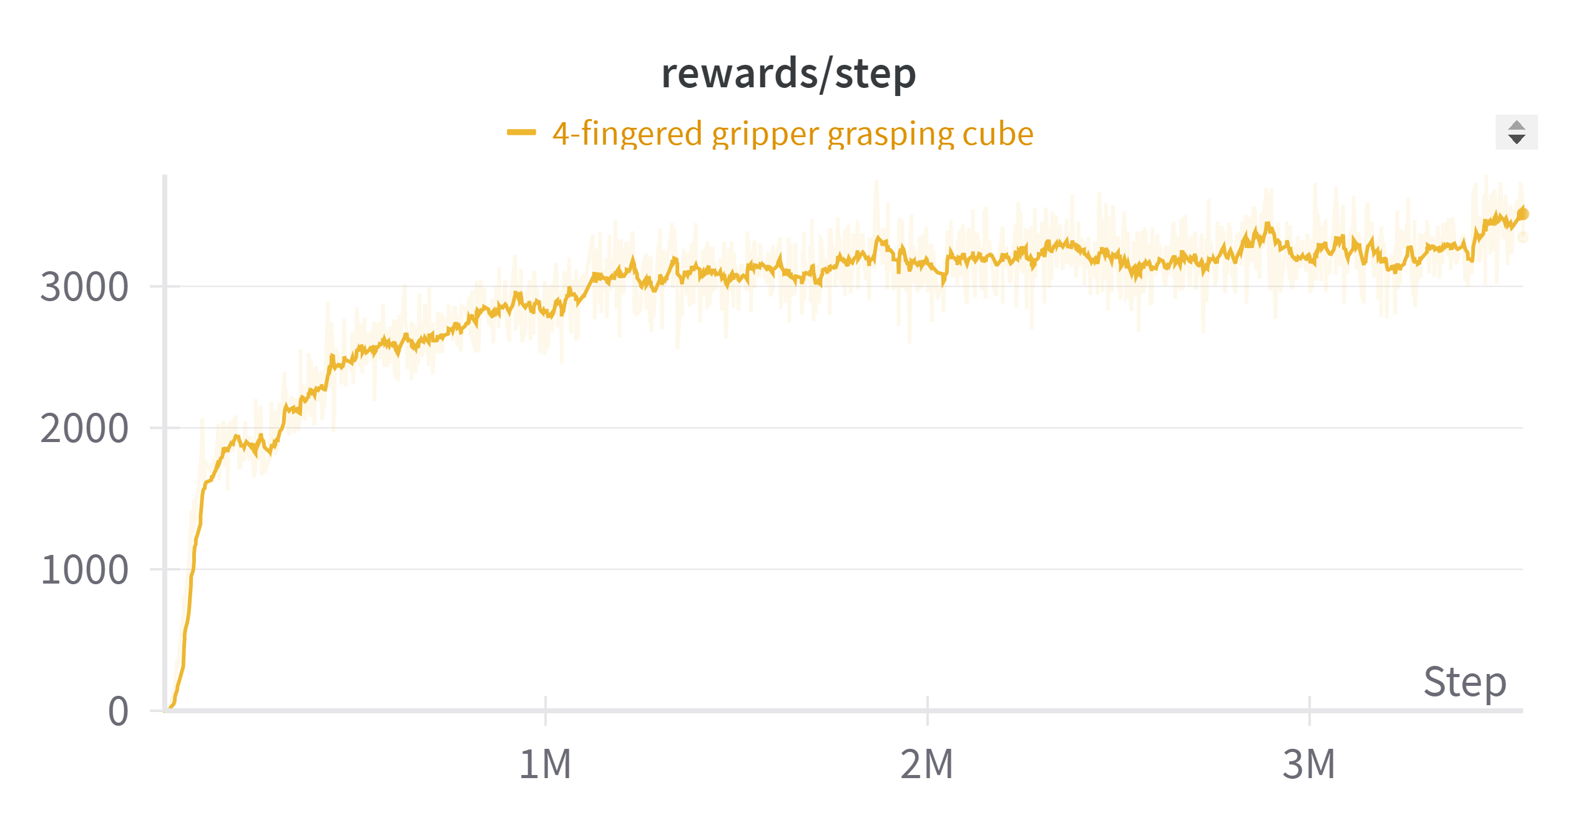
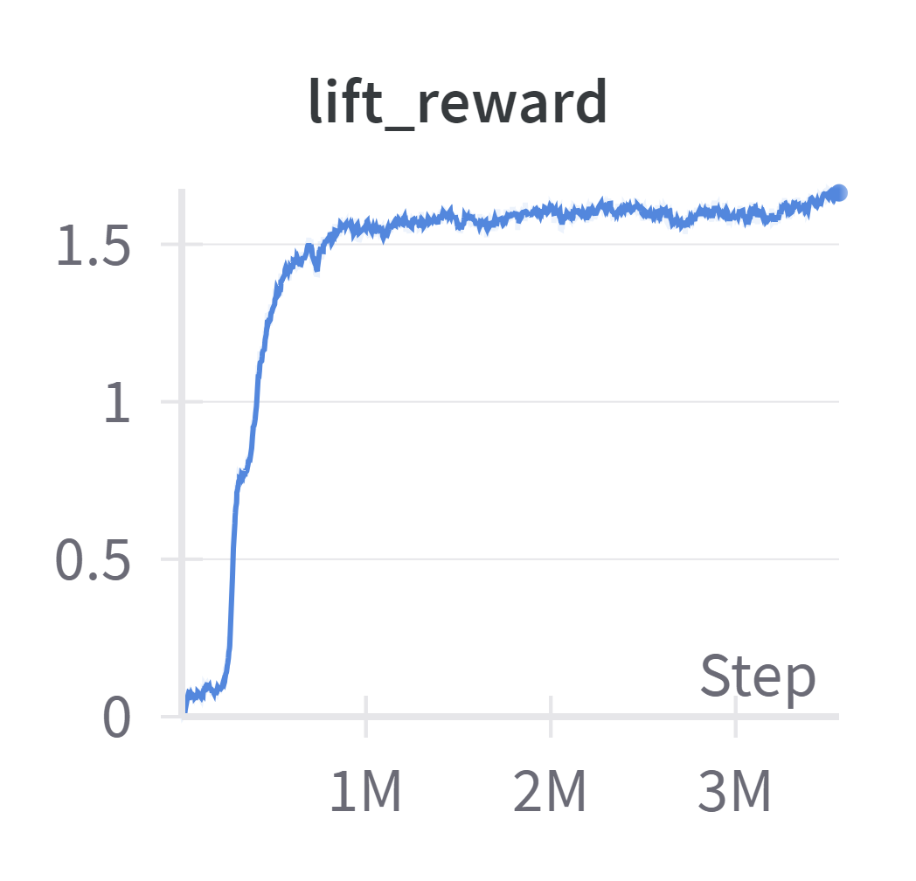
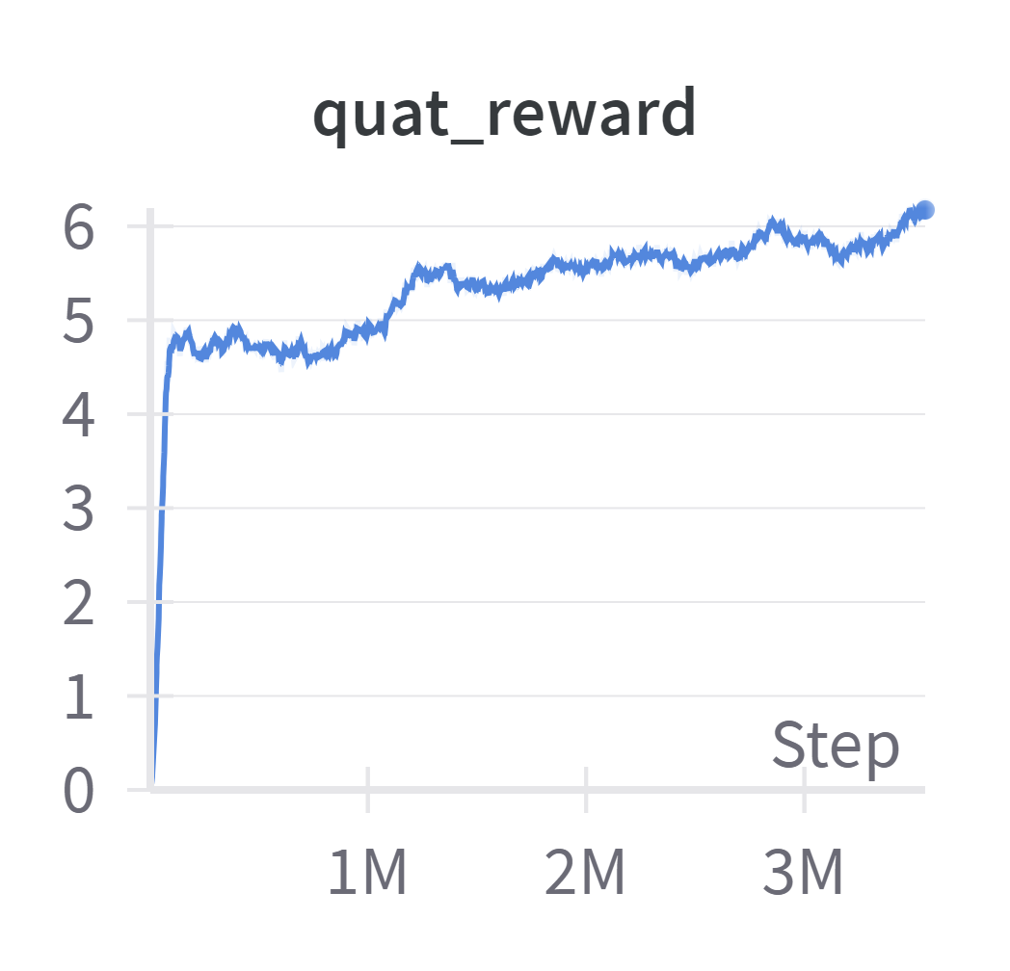
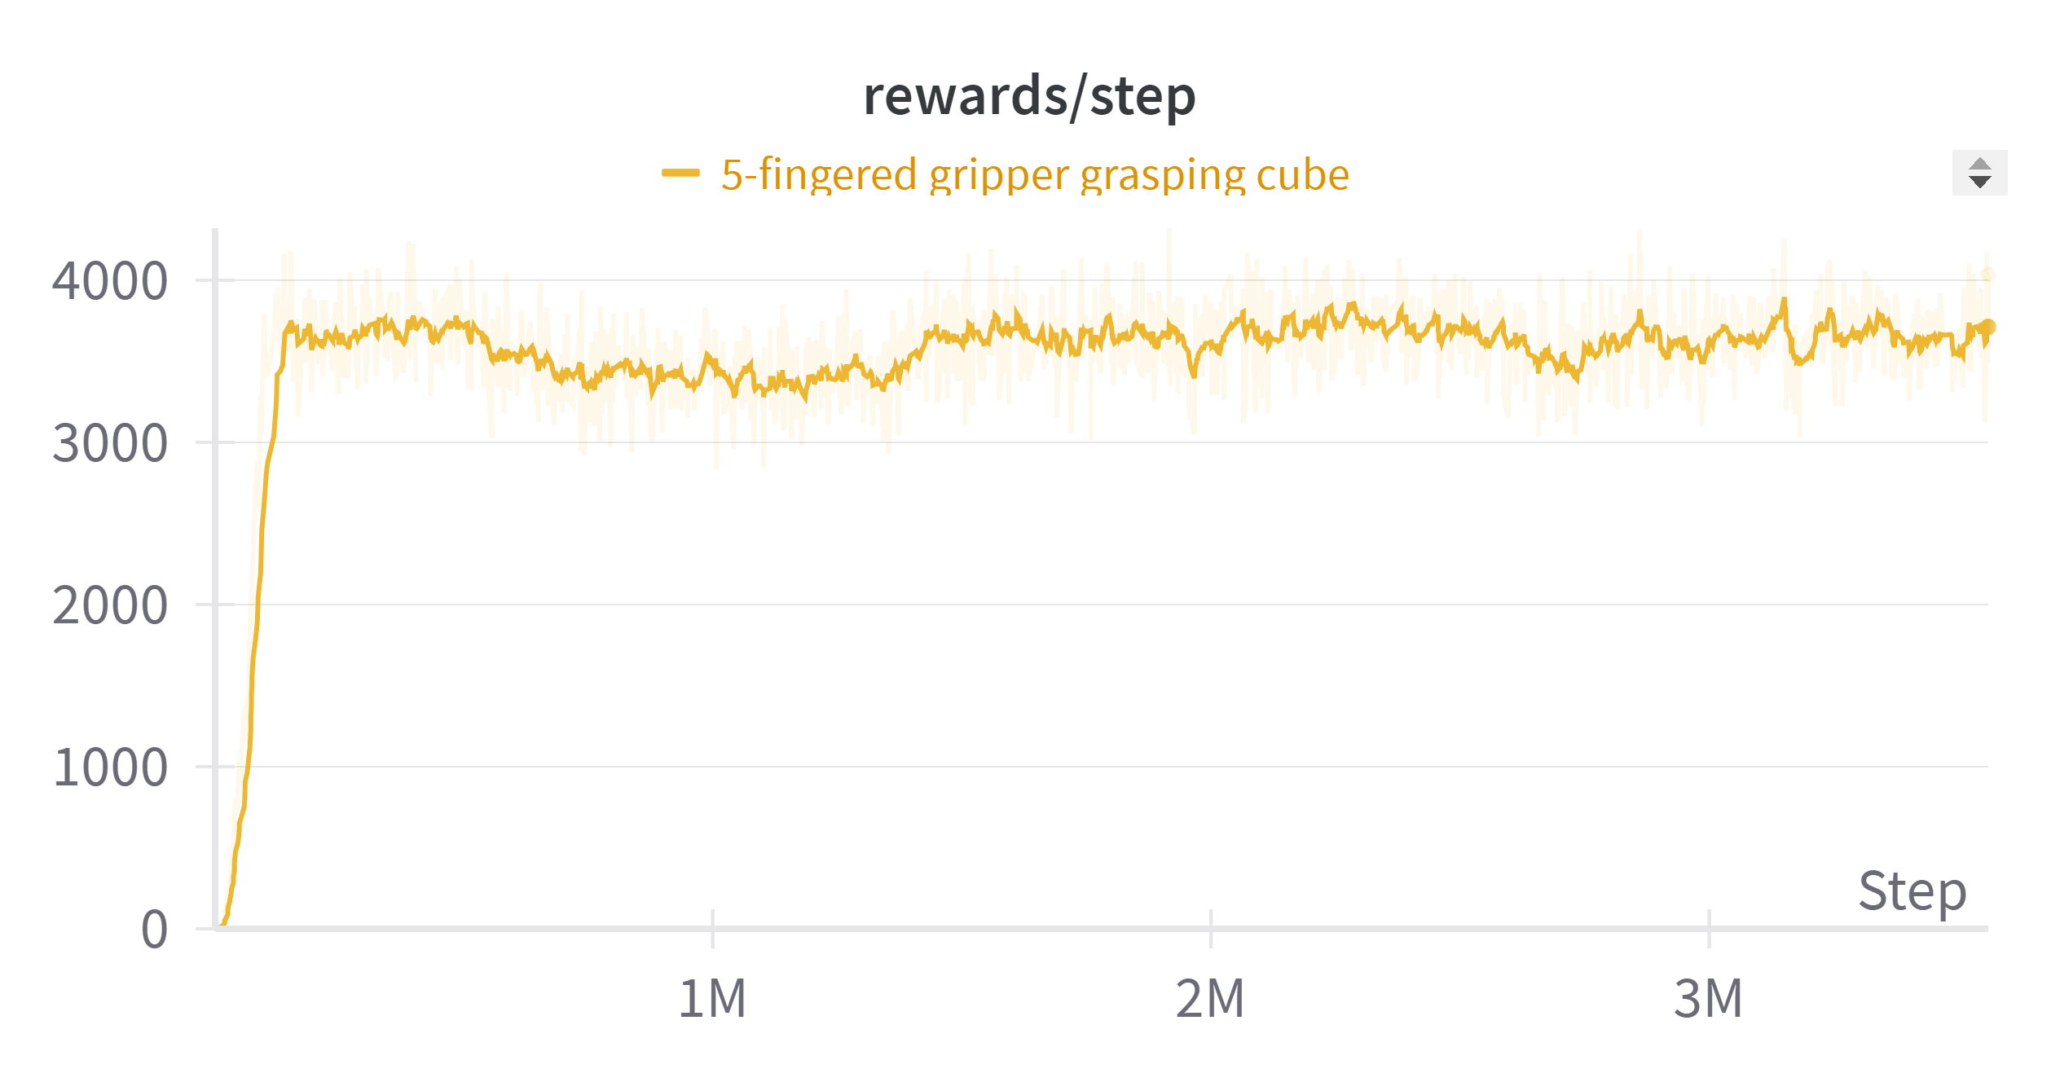
Gripper performance
4-fingered
4-fingered gripper
Performance of different finger configurations grasping the cube
- Stable reward throughout the training period
- Reduce the scale of quat_reward, increase goal_reward → make the gripper more focused on lifting the object to the target height
5-fingered
5-fingered gripper

Slide 5
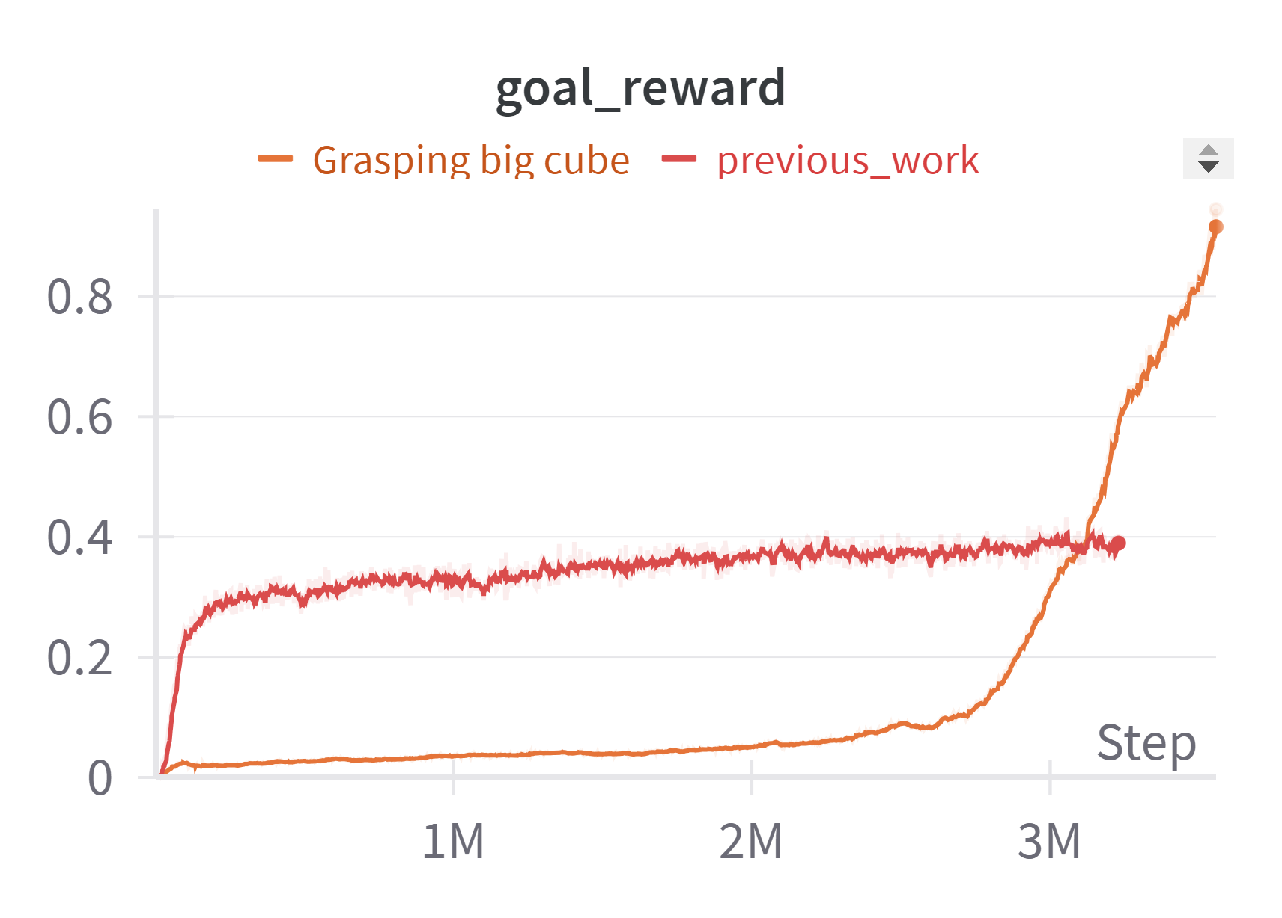
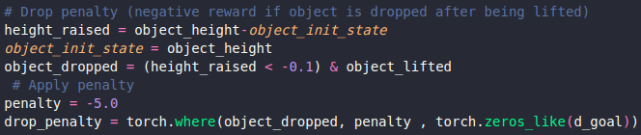
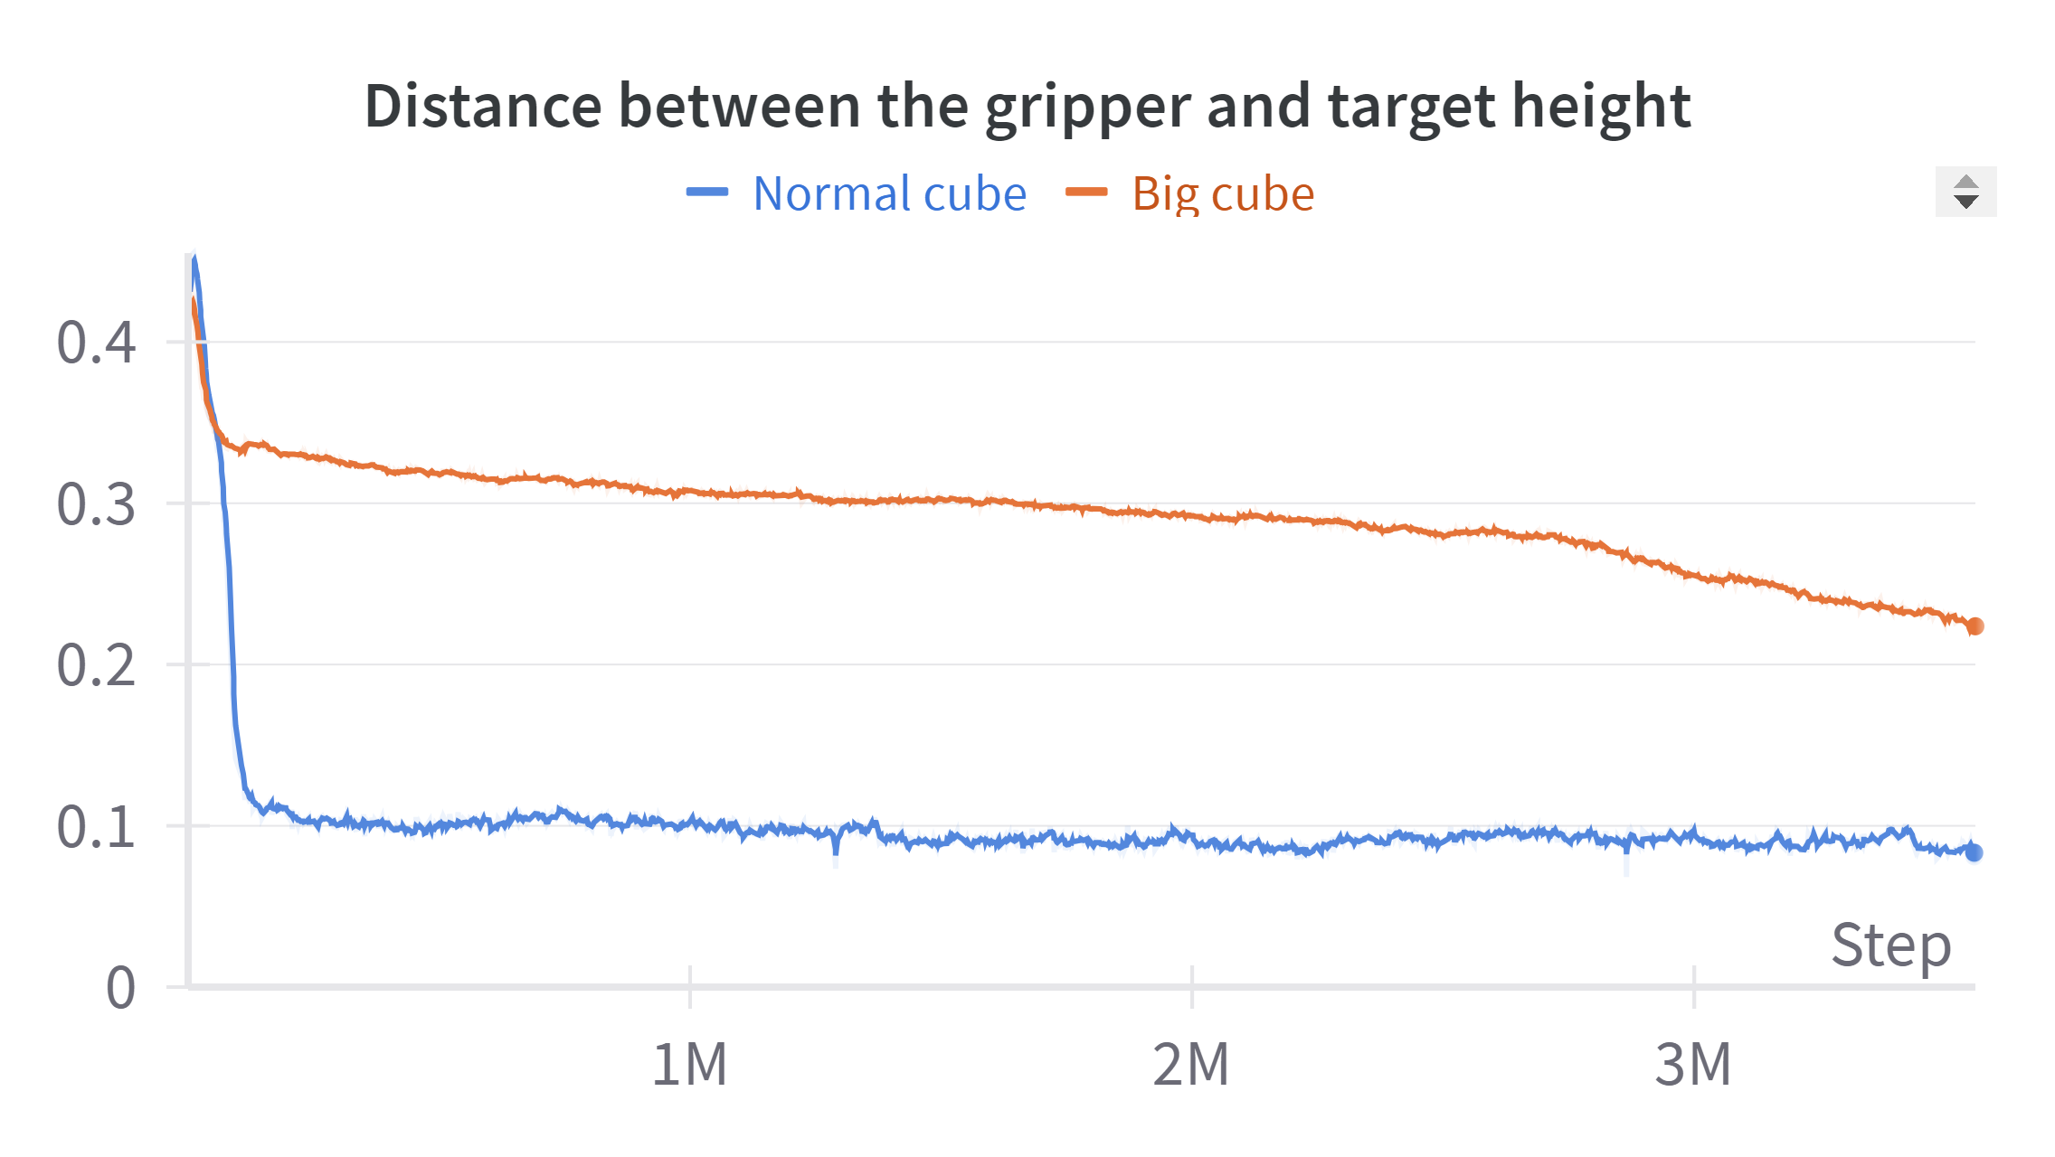
Gripper performance
Performance with big object
- Penalize the gripper for dropping the object after lifting
Better goal reward → The gripper is learning to bring the object closer to the target height
Slow convergence → the gripper struggles to make fine adjustments needed to position the object exactly at the desired height.

Slide 6
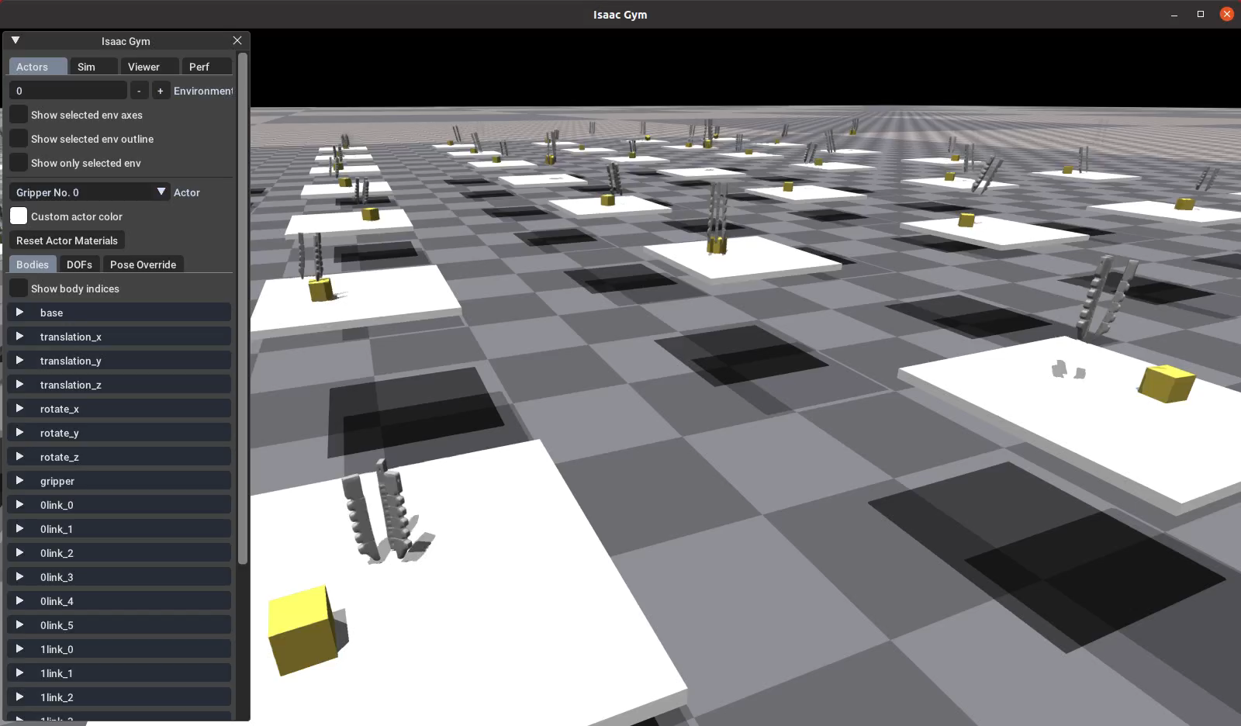
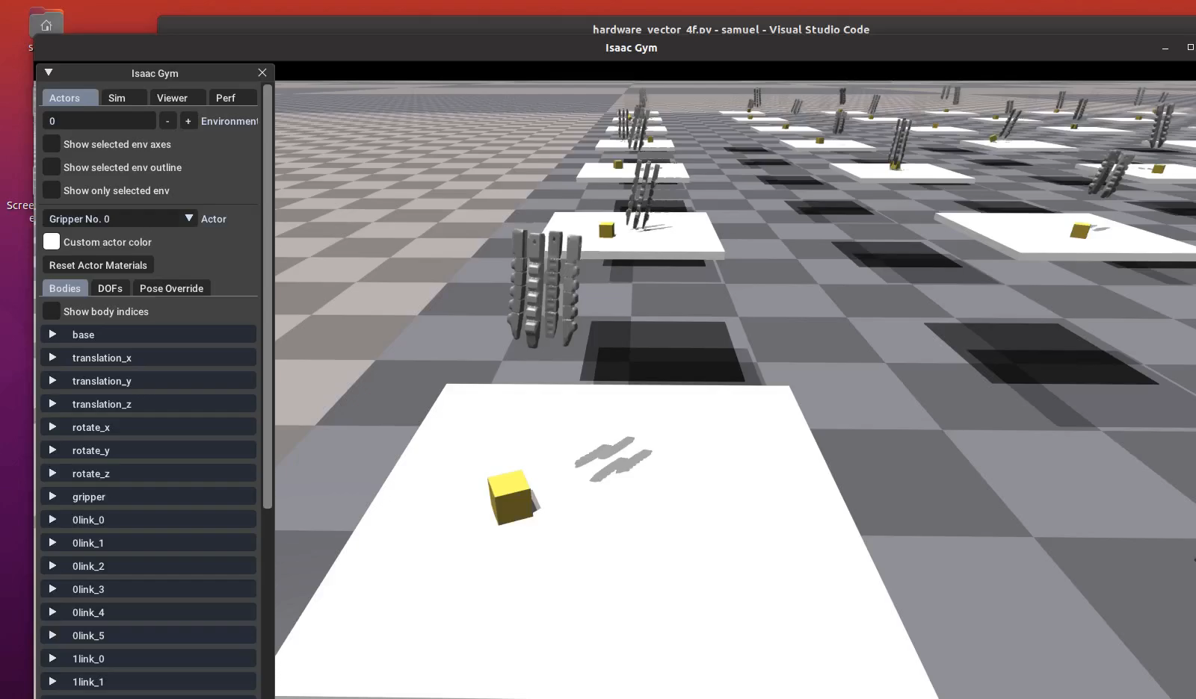
Gripper performance
- Successfully grasp bigger objects
- Difficulty in lifting the object to the exact target height
Video
3-fingered gripper
4-fingered gripper

Slide 7
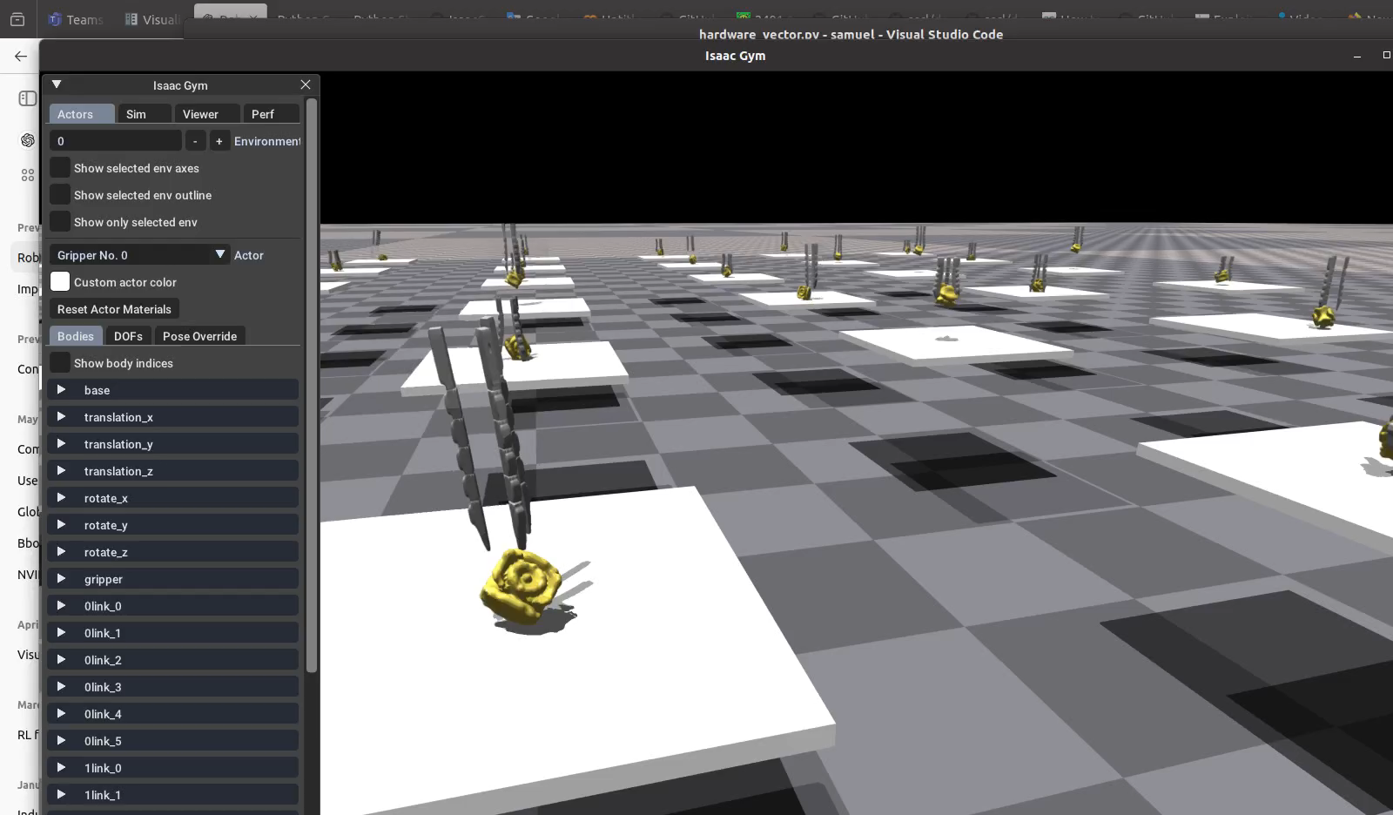
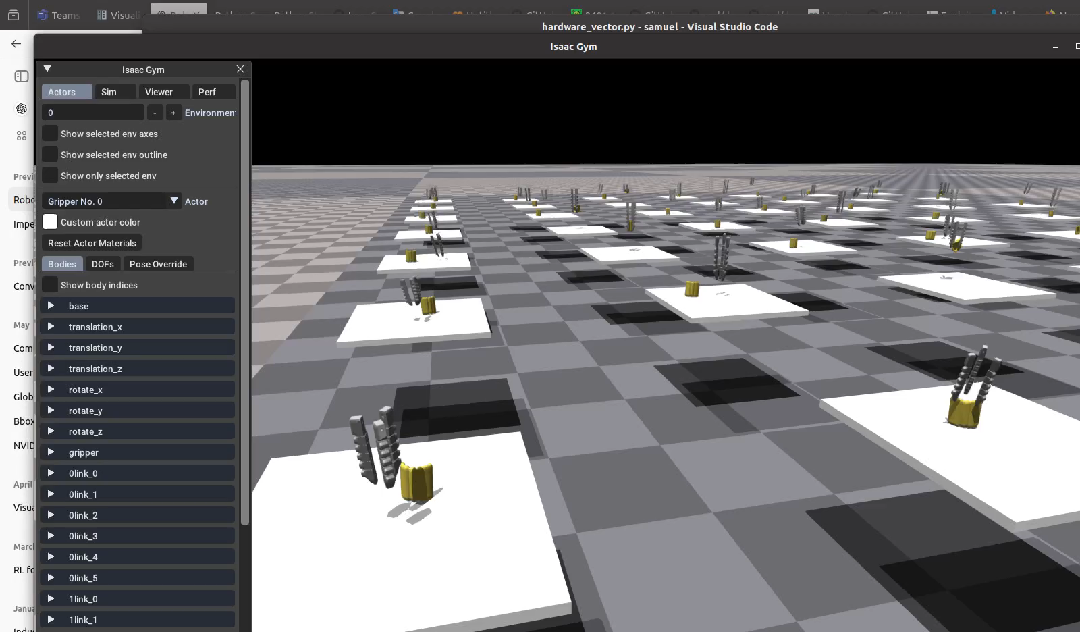
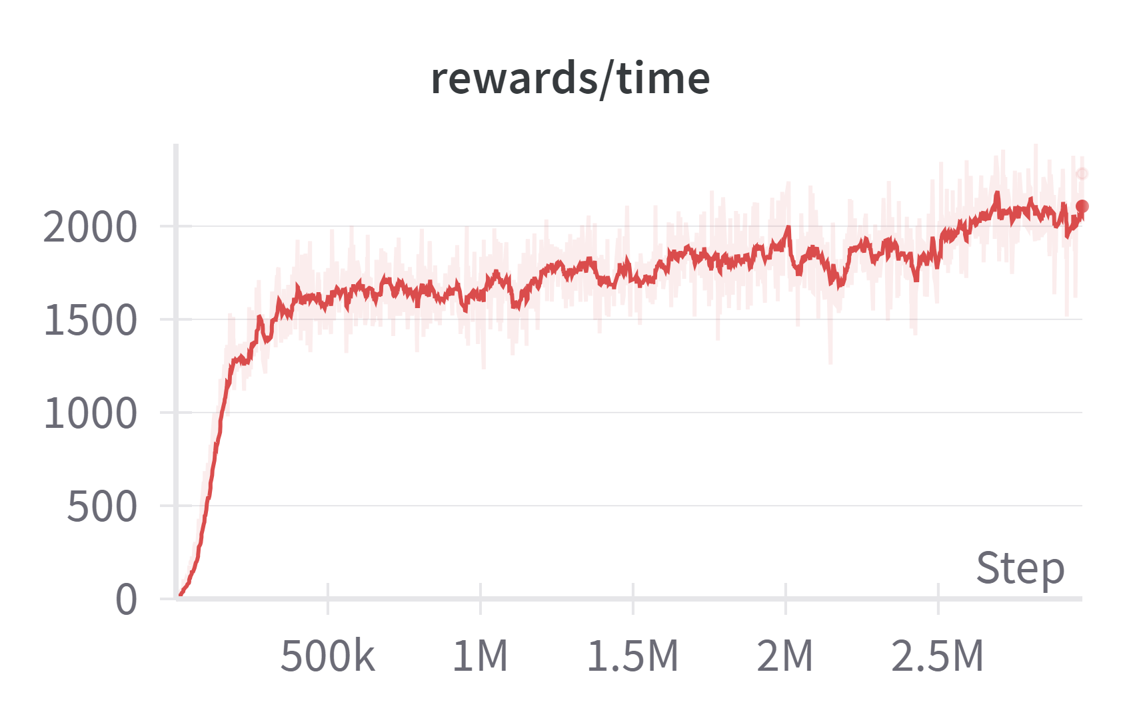
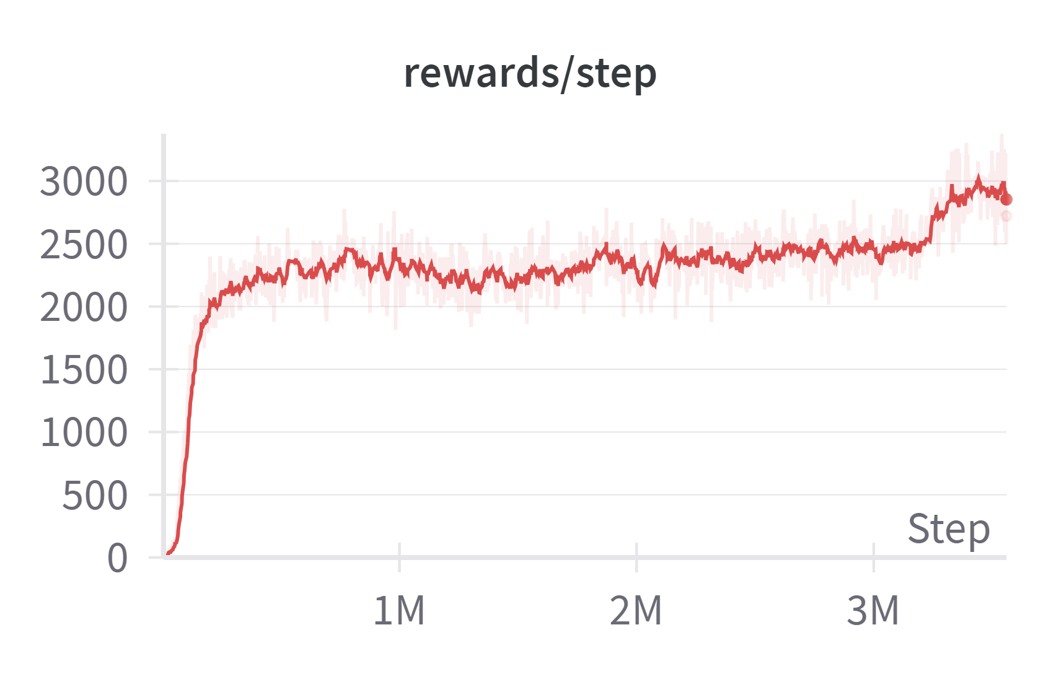
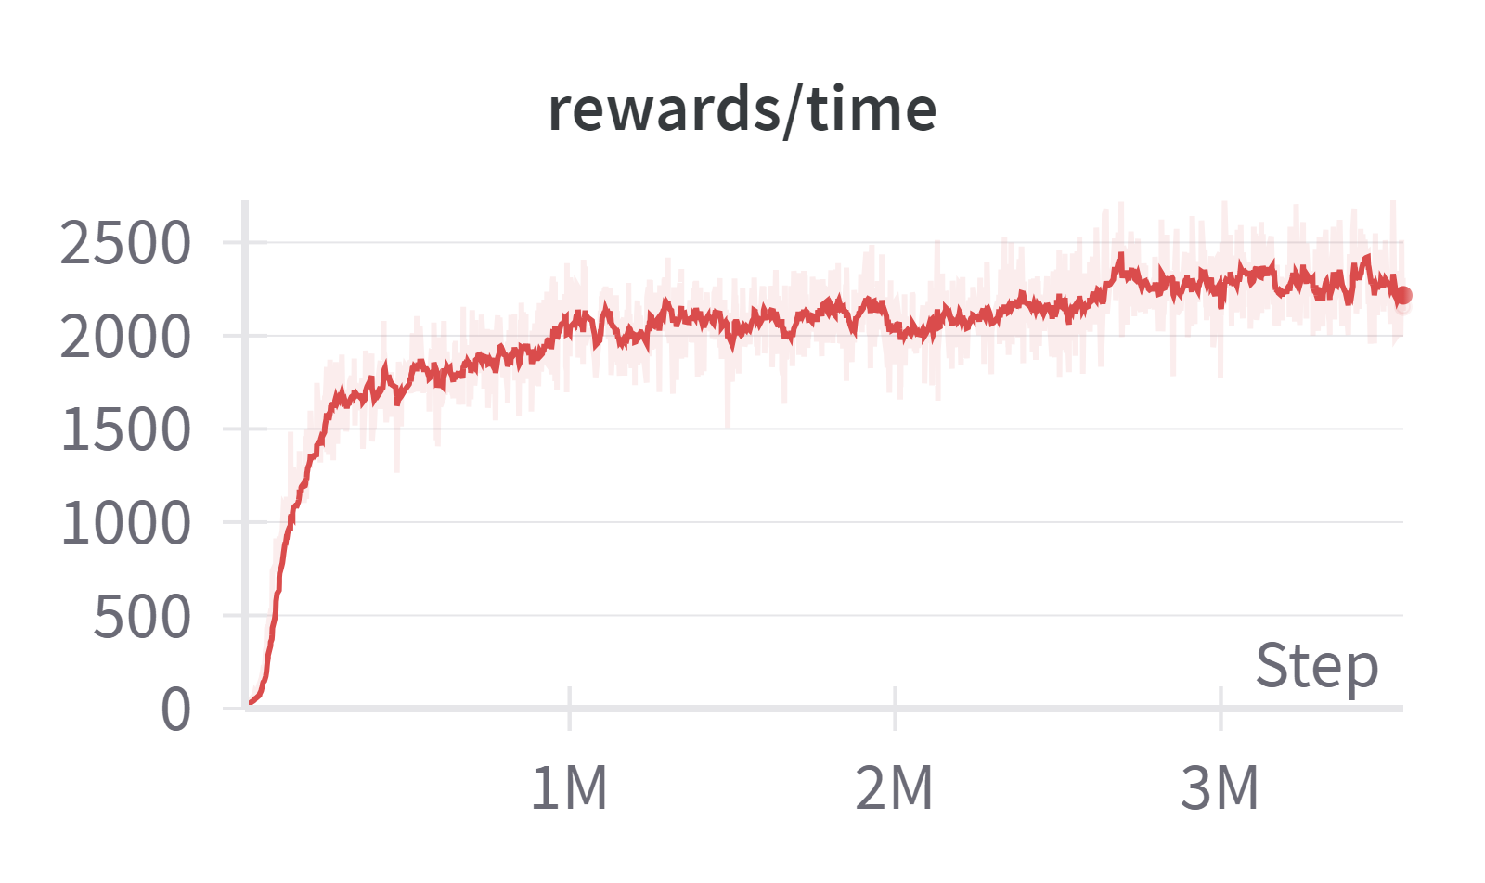
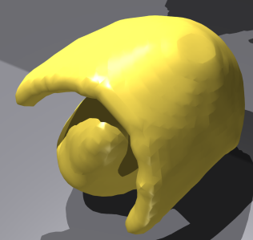
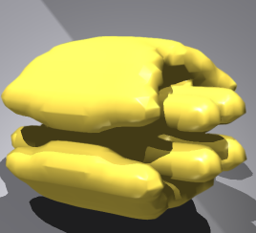
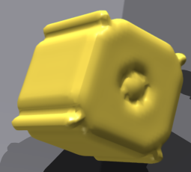
Performance on different objects
Performance of training the gripper to grasp other objects with different shapes
object_0
object_1
object_2

Slide 8
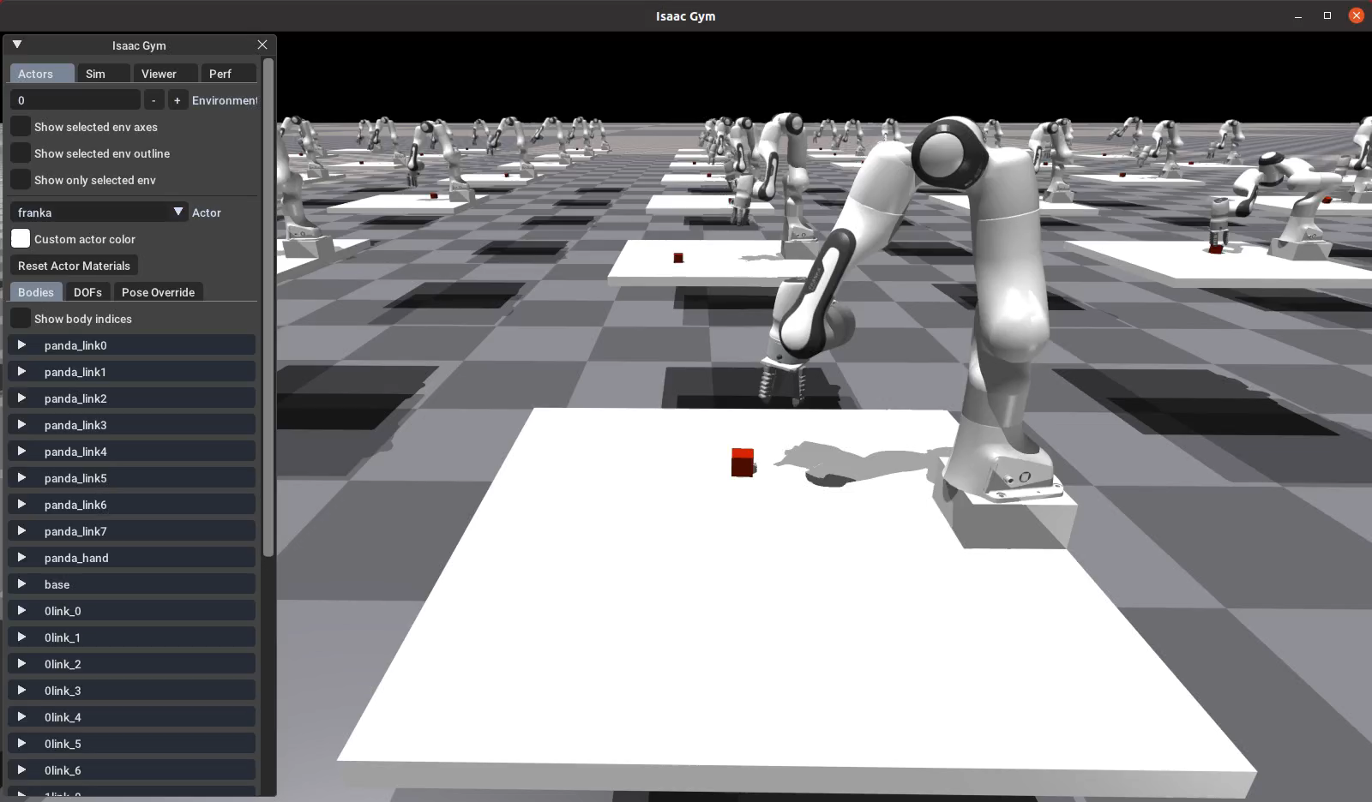
Franka Panda with soft gripper simulation
Setting up environment for robot arm training
Operational Space Control for robot arm:
+ perform tasks in Cartesian space (end-effector's pose) instead of joint space (joint angles)
+ desired end-effector pose → joint torques
→ Extract joint positions and velocities
calculate mass matrix
compute eef inertia matrix from jacobian tensor
→ transform Cartesian action to joint torques by PD-control

Slide 9
Thanks!

